Slide 1
JDI Settings

Slide 2

PLAN
JDI Intro
JDI UI objects and Complex elements
JDI Tables and custom elements
JDI Settings. EDT. DDT. Test runs
Around JDI. Reports. Logs. Grid. Asserts

Slide 3
AGENDA
JDI Settings
Search element and page load strategies
Auto driver download.
Use maven for run tests with different properties
Test approaches: EntityDriven Testing, Data Driven Testing(DataProviders) etc.

Slide 4
Test project

Slide 5

Jdi setup
Maven
, Gradle, Ivy
<dependency>
<groupId>com.epam.jdi</groupId>
<artifactId>jdi-uitest-web</artifactId>
<version>LATEST</version>
</dependency>
https://github.com/epam/JDI-Examples

Slide 6
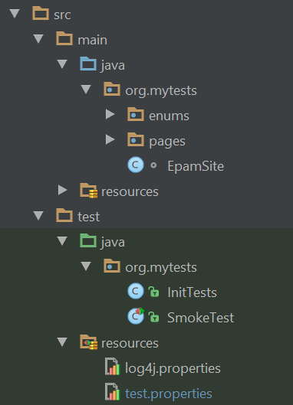
structure
https://github.com/epam/JDI-Examples
test.properties
log properties
ui objects
test init
tests

Slide 7
Test PROPERTIES

Slide 8
DOMAIN & DRIVER
test.properties
pom.xml
<properties>
<domain>https://www.epam.com/</domain>
<driver>chrome</driver>
<timeout>10</timeout>
</properties>
domain=https://www.epam.com/
driver=chrome
timeout.wait.element=10
domain=${domain}
driver=${driver} timeout.wait.element={timeout}
Maven
mvn clean install –Ddomain=https://test.epam.com –Ddriver=firefox

Slide 9
DOWNLOAD DRIVER
driver=chrome
browser.size=1800X1000
driver.getLatest=true
driver.version=2.34
drivers.folder=C:\\Selenium
WebSettings.useDriver(“chrome”)
CHROME = "chrome"
FIREFOX = "firefox"
IE = "ie"
WebSettings.useDriver(CHROME)
WebSettings.useDriver(() ->
new RemoteWebDriver(sauceUrl(), firefox()));

Slide 10
DRIVER SETTINGS
SeleniumDriverFactory
SeleniumDriverFactory.webDriverSettings = driver -> driver;
webDriverSettings = driver -> {
driver.manage().addCookie(new Cookie("test", "QA"));
return driver;
};
modifyCapabilities = cap -> {
cap.setCapability(PAGE_LOAD_STRATEGY, “eager”);
return cap;
};

Slide 11
WAIT timeout
GLOBAL
timeout.wait.element=10
ELEMENT
submitButton.setWaitTimeout(10)
ELEMENT
label.wait(el -> el.getAttribute("status").equals("update"))
ASSERT
Assert.areEquals(()->status.getText(), "Ready");

Slide 12
STRATEGIES
page.load.strategy=normal | eager
eager
normal
none
search.element.strategy=strict | soft | visible, multiple | any, single
visible - accept only visible elements;
any - accepts any elements found in dom
single - if found more than 1 element > throw error
multiple - if found more than 1 element > takes first element
strict = visible, single
soft = any, multiple
screenshot.strategy=on fail | on | off

Slide 13
Element search
@BeforeSuite (alwaysRun = true)
public static void setUp() {
SeleniumDriverFactory.elementSearchCriteria =
el -> el.isEnabled() && el.isDisplayed();
// el -> el != null;
};
@Test()
public void simpleTest() {
sumResult.waitFor(el -> el.getText().equals(“5”));
sumResult.select(5);
};

Slide 14
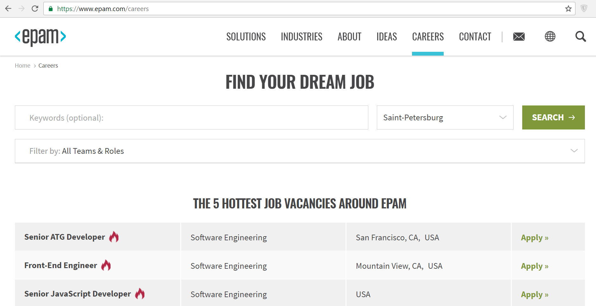
DEMO
demo.mode=false | true
demo.delay=2
Demo developed features to Product owner
Newcomers adaptation

Slide 15
GROUP LOCATORS

Slide 16
@JFindBy(css = “.main-title“, group = “1.7”)
@JFindBy(css = “.home-label“, group = “2.0”)
public ILabel title;
@JFindBy(xpath = “//*[text()=‘Далее’]“, group = “ru”)
@JFindBy(xpath = “//*[text()=‘Next’]“, group = “en”)
public IButton next;
@BeforeSuite (alwaysRun = true)
public static void setUp() {
JDIData.group = “1.7”; // = “ru”
init(AwesomeSite.class);
};

Slide 17
LOCALIZATION TESTING
@BeforeSuite (alwaysRun = true)
public static void setUp() {
JDIData.group = “en”;
MapInterfaceToElement.update( new Object[][] {
{ IDropDown.class, EnDropDown.class},
{ IButton.class, EnButton.class}
});
init(AwesomeSite.class);
homePage.open(“en”);
};

Slide 18
Parallel test run

Slide 19

parallel test run
<?xml version="1.0" encoding="WINDOWS-1251"?>
<!DOCTYPE suite SYSTEM "http://testng.org/testng-1.0.dtd">
<suite name="Test suite" parallel="methods" thread-count="1">
<test name="Tests" preserve-order="true">
<classes>
<class name="org.mytests.tests.example.SimpleTest"/>
<class name="org.mytests.tests.example.ComplexTest"/>
<class name="org.mytests.tests.example.SmokeTest"/>
</classes>
</test>
</suite>
Write tests independent on
Data
Order
State
https://howtodoinjava.com/testng/testng-executing-parallel-tests/

Slide 20
preconditions
Independent tests
Time optimization
JDI Page precondition
homePage.isOpened();
Precondition
JDI State precondition
IsInStateCheckAction
MoveToStateAction
isInState(LOGGED_IN)
PreconditionsState.isInState(LOGGED_IN)
public enum Preconditions implements IPreconditions {
CALC_INIT(() -> calculator.value == 0,
() -> { calculator.clear(); calculator.clearMemeory() }),
CAREERS_PAGE("/careers");
}

Slide 21
PERFORMANCE TESTING
@Test(threadPoolSize = 4, invocationCount = 1000, timeOut = 100)
public void testMethod() {
….
}

Slide 22
Entity driven testing

Slide 23






EDT: DATA DRIVEN TESTING
Provide List<User> for test

Slide 24


EDT: PRECONDITIONS
Provide List<User> for test
0. Have DefaultUser in DB
?
+

Slide 25

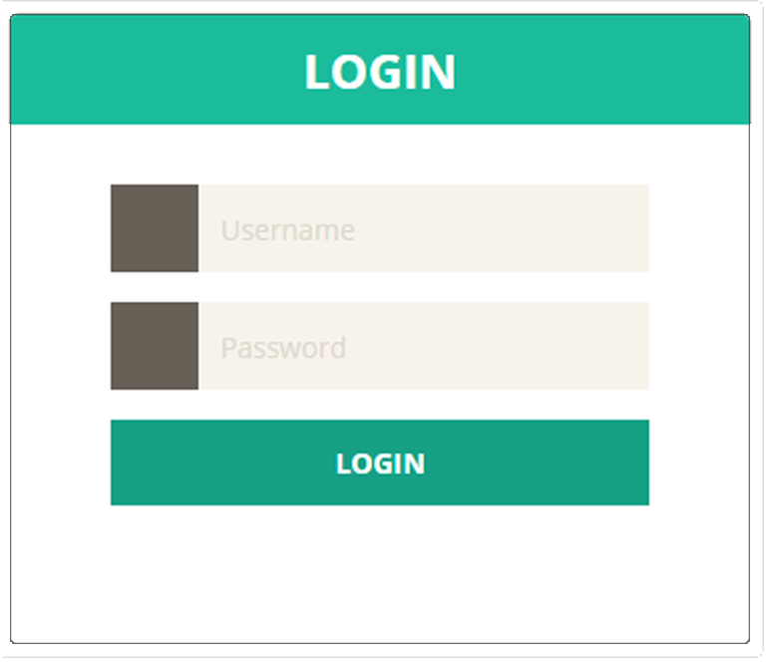
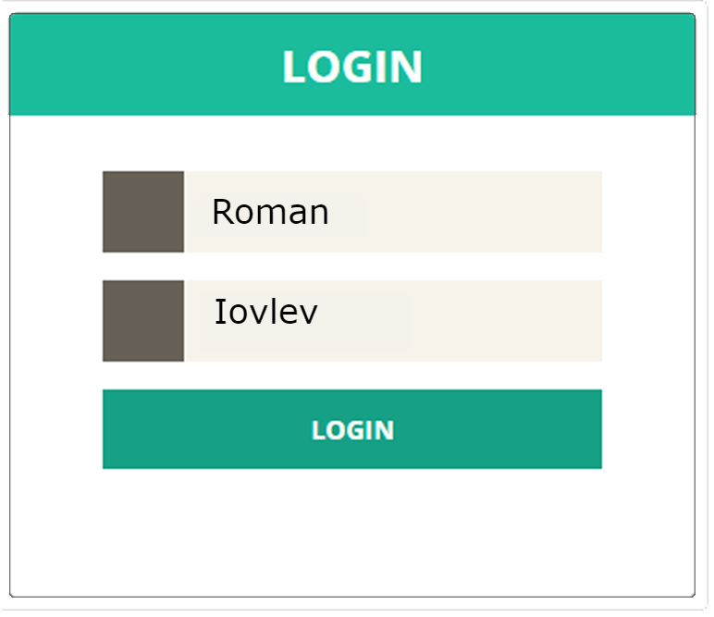
EDT: FILL AND SUBMIT
Provide List<User> for test
0. Have DefaultUser in DB
Login with DefaultUser

Slide 26

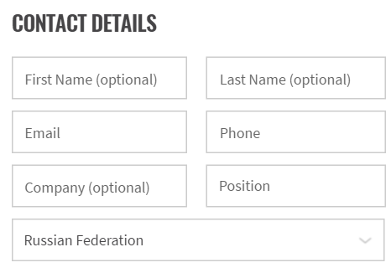
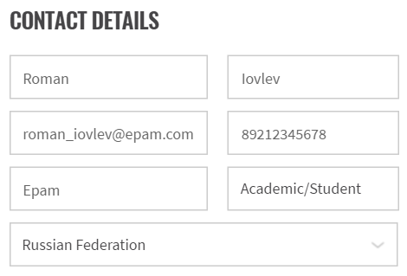
EDT: FILL AND SEND
Provide List<User> for test
0. Have DefaultUser in DB
Login with DefaultUser
Submit Contact Us Form for DefaultUser

Slide 27

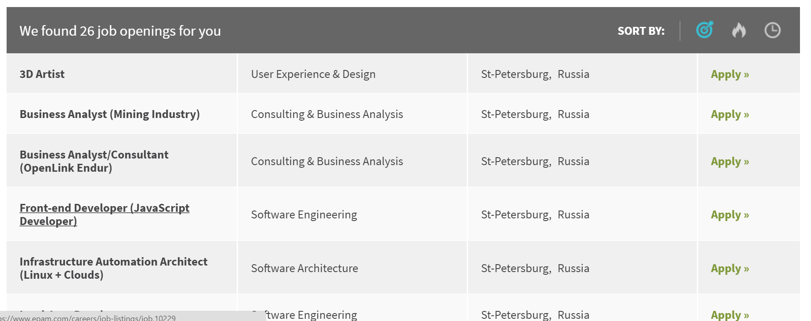

EDT: EXTRACT
Provide List<User> for test
0. Have DefaultUser in DB
Login with DefaultUser
Submit Contact Us Form for DefaultUser
Get Act. Opening from Vacancy table

Slide 28

EDT: VALIDATE
Provide List<User> for test
0. Have DefaultUser in DB
Login with DefaultUser
Submit Contact Us Form for DefaultUser
Get Act. Opening from Vacancy table
Assert Act. Opening equals to Exp. Opening
Actual
Expected

Slide 29
DATA DRIVEN TESTING
public class UsersProvider {
@DataProvider(name = "users")
public static Object[][] users() { return new Object[][]{
{ defaultUser, adminUser, wrongUser } };
}
@Test(dataProvider = "users", dataProviderClass = UsersProvider.class)
public void loginTest(User user) {
DB.addNewUser(user);
loginForm.loginAs(user);
manageUsersPage.open();
User userInTable = manageUsersPage.usersList.entity(u-> u.id == user.id);
Assert.areEquals(userInTable, user);
}

Slide 30
Good practices

Slide 31
remember
Test Scenarios should be clear for understanding. Every man can read and understand them (client, test engineer, analyst):
Move all things not related to scenario out in separate modules. Common test parts move in to before/after test. Combine 3 or more asserts followed one by one in one step check
Limit your test scenarios with 10-15 lines. Test class with 150-200. In other case You can logically split your test classes in to several suits with high chances
Tests names should clearly say about their essence
Each test scenario line should represent one business step
All test checks/asserts should be in test scenario as step. You should not hide them in to steps

Slide 32
remember
Test scenarios are useless without right test infrastructure:
Tests should run on regular basement on CI. Your test scenarios should be ready to get settings from command line (environment domain, test group, browser etc.)
Test suit should work stable on stable build. If some tests falls randomly. You must fix them or temporarily remove them from test suit
Tests should represent all info about test run in suitable format. They should provide detailed enough log about scenario steps and provide visible reports

Slide 33
remember
Tests should be independent. Each test should be run separately. Use preconditions in order to move test to expected state. Tests should not disturb one to another. If some tests should use common data then move them in separate group
Never use ThreadSleep. Wait some application state (page load, end of ajax…) or next element appearance instead
Use your brain and get pleasure from testing. If automation testing not make you happy possibly you doing something wrong. Think about it

Slide 34
NEXT
JDI Intro
JDI UI objects and Complex elements
JDI Tables and custom elements
JDI Settings. EDT. DDT. Test runs
Around JDI. Reports. Logs. Grid. Asserts

Slide 35
HOME WORK
Setup your tests using different properties
Create test runs on different versions of different browsers
Write your tests using EDT and Data Providers
Run tests in parallel

Slide 36



Questions
roman.iovlev
roman.iovlev.jdi@gmail.com

